Slide 1
ITWS - Midterm 2
Stefan Cliff 2019/230449
Student – Professor - Course

Slide 2
Introduction
The system I made an application for is a simple Student – Professor – Course type of project. Where you can create/add new Students or Professors to a course, remove them from the database or edit any or all of their credentials in a simple user friendly manner. The application is a CRUD (Create, Read, Update, and Delete) style, meaning via the app you can directly control certain/all the tables to the database you wish to alter. In this example, the Database is called ITWS_Midterm2_SC with its tables being: - students; - professors; & - courses;
I wanted the idea of adding new students and professors to be to main part of the application, with editing/viewing them being of equal importance. As well as deleting. All of these functions where done via Servlets and SQL commands that were run on my localhost server.

Slide 3
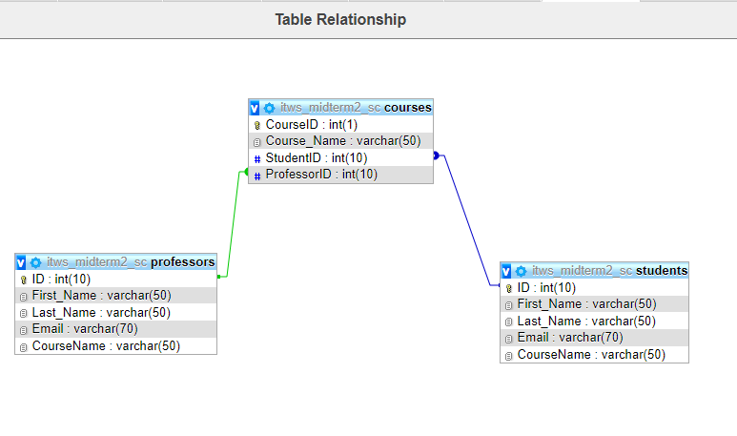
Database
The database is called ITWS_Midterm2_SC, and its tables are professors, students and courses. All of this I mentioned before, but here I will show the tables themselves, their configurations and their relationships to one another.

Slide 4
Implementation
The implementation of my code was similar in a lot of places, and due to that I'll only really show some of the snippets from the servlets that were aimed at the same table for the sake of brevity and to avoid repetition. And I'll only show the CRUD servlets as well.

Slide 5
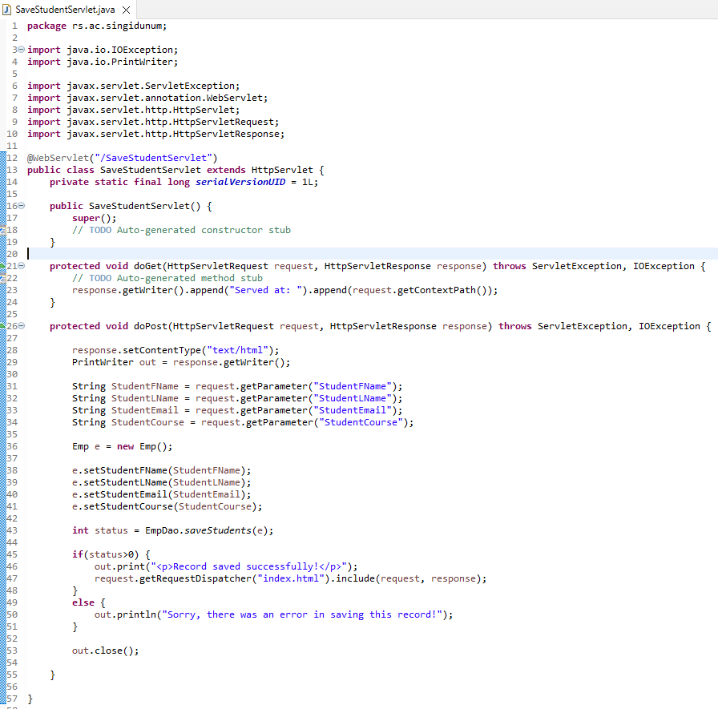
Create

Slide 6
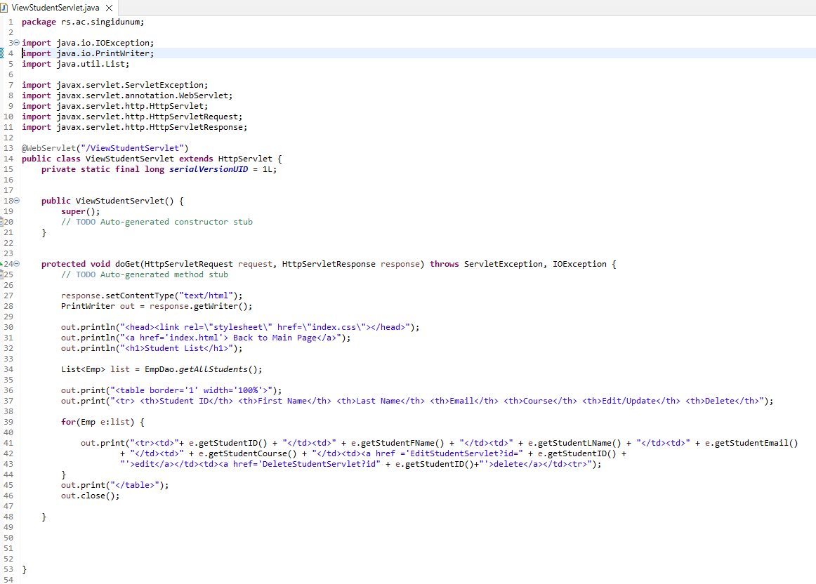
Read

Slide 7
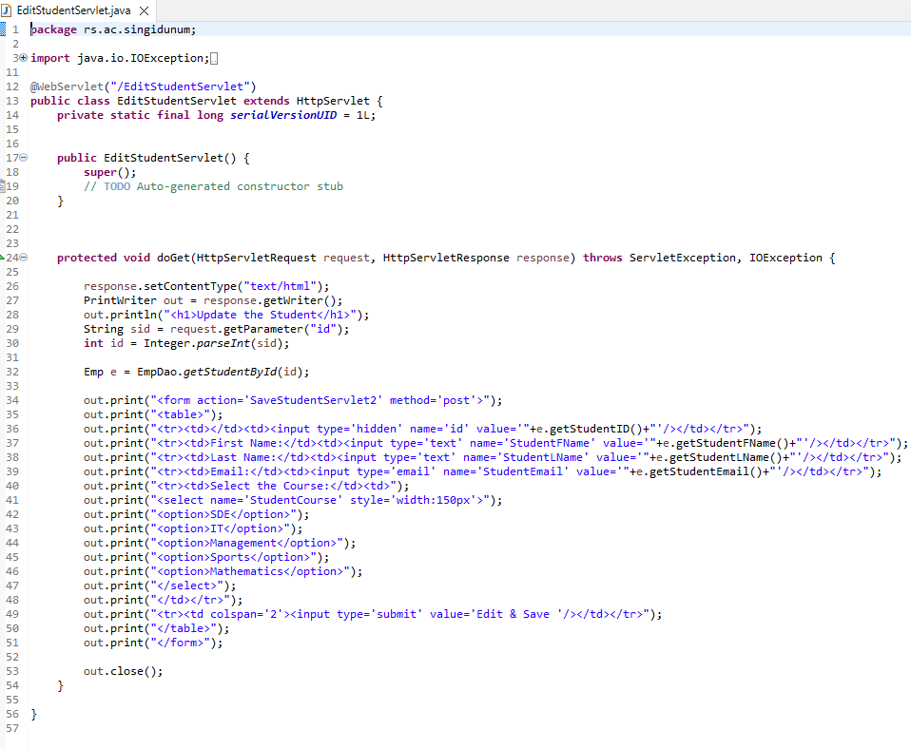
Update I

Slide 8
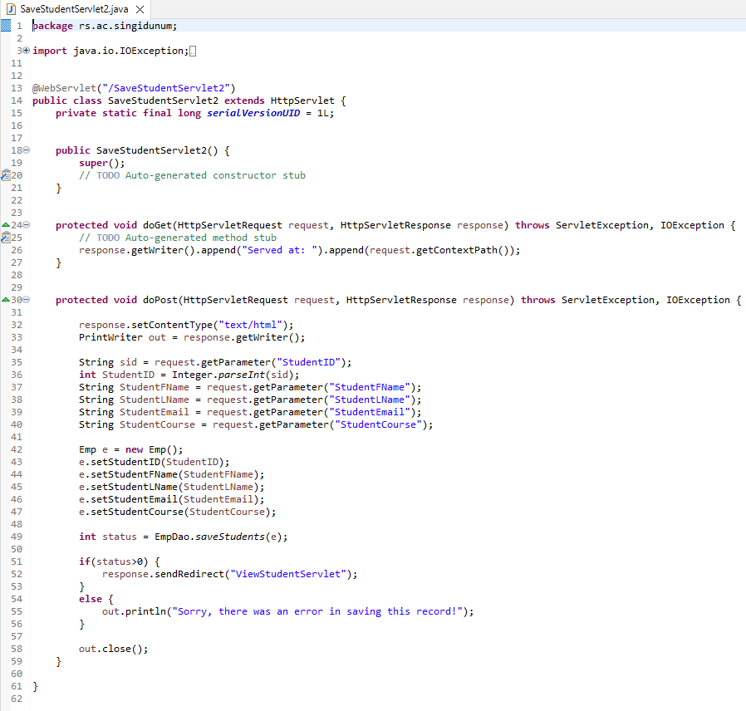
Update II

Slide 9
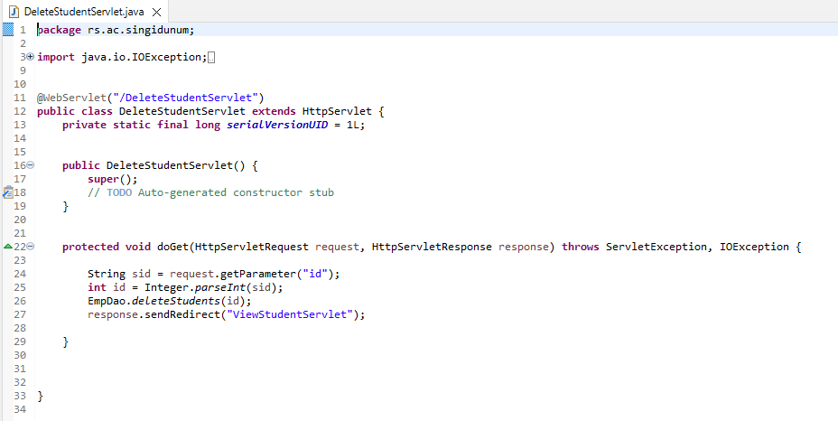
Delete

Slide 10
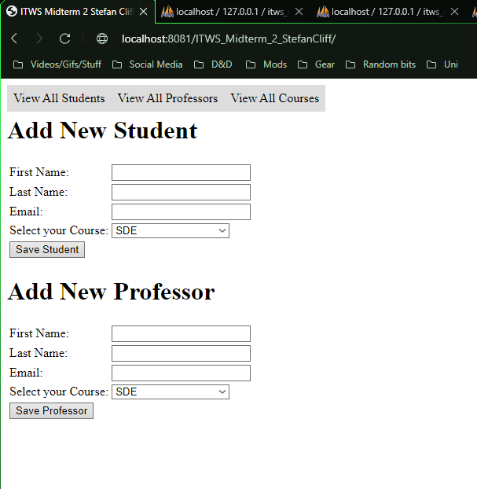
Functionality I
As you can see here, the first page/landing page is a simple form for adding either a new Student or Professor. Along the top you also have access to three buttons, each of which are self-explanatory.

Slide 11
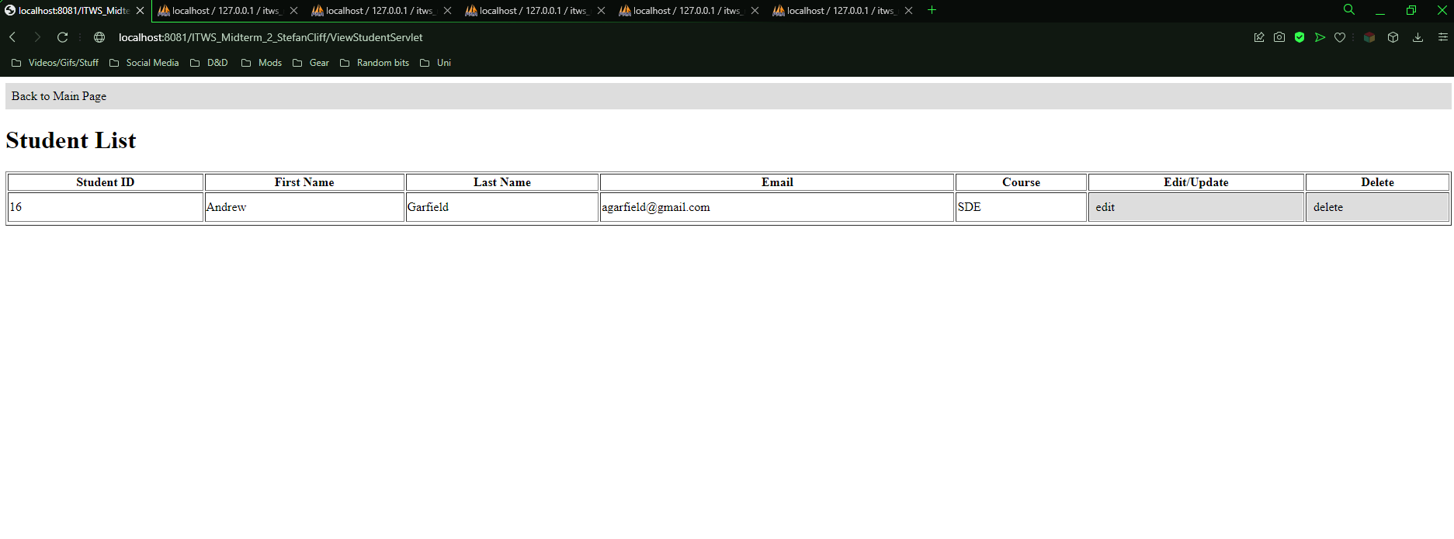
Functionality II
This is what the View All Students page looks like
Along the right edge of each student there is an edit/update as well as a delete button.

Slide 12
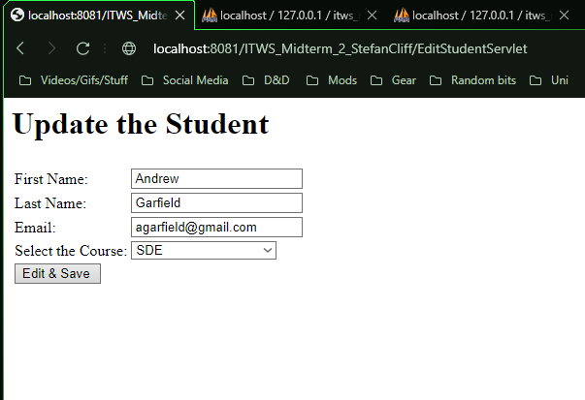
Functionality III
If you were to click on the edit button next to a student from the View All Student list, you would then be taken to this page bellow.

Slide 13
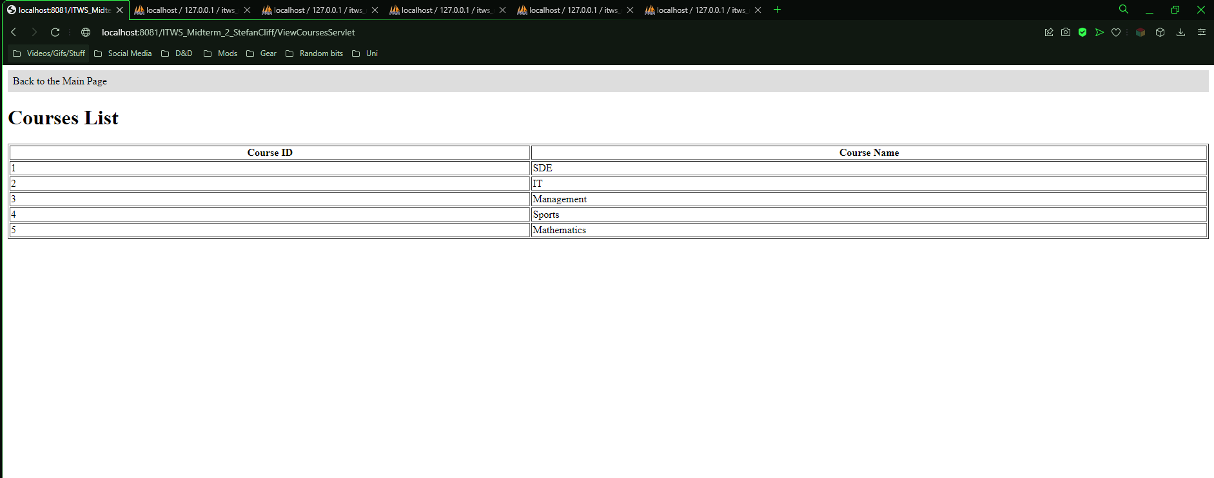
Functionality IV
This is what the View All Courses window will show you.
I didn't add any screen shots of the View All Professor nor the Edit/Update Professor windows as they are very similar to the Student ones.

Slide 14
Conclusion
All and all, the task was simple in idea but it was a bit tricky in places still to implement. Some obvious improvements would be on the GUI side of this, the colouration and formatting could have been done better.
I didn’t write as many comments while writing the code as I usually do, which might prove to be a hindrance in future if I ever come back to this project to fix or add anything. But besides that, maybe adding a way to filter or sort through all the students based on GPA or something along those lines would be an interesting addition to be sure. As well as adding more students and professors as a whole, which would make the application feel a bit less barebones than it is in reality.
Besides that, I am unsure what I could change or add without redoing the whole project from the ground up and re-imagining its core idea to some extent. Maybe adding a way to see all the students that are in a course and its professor could have been a nice touch to add, but honestly I couldn’t really figure out how to would work to some extent. I have a pretty solid idea, but the more I think about it, the more it seems like a lot of extra work that I am certain I don’t have the time for.
I could add a few levels of user warnings for the deleting part of the application, because right now a simple miss click could in theory delete a whole person…. which isn’t the safest for practical use.

Slide 15
Final Words
,, Always approach every situation as if the users are idiots. “
- Dr Miodrag Živković, 2019

